Slide 1


DATA SCIENCE
UNIT 6- Selected AI Techniques
Presented by:
Sachin Saxena
SME, upGrade

Slide 2
Introduction to SVM:
Support Vector Machines, or SVMs, are a class of extremely popular classification models. Besides their ability to solve complex machine learning problems, they have numerous other advantages over other classification problems, such as the ability to deal with computationally heavy data sets, classifying nonlinearly separable data, etc.
It is important to remember that SVMs belong to the class of linear machine learning models (logistic regression is also a linear model).

Slide 3
Introduction to SVM:
In our (somewhat simplified) example of email classification, the features are the ‘frequency of words’ in an email.
Word frequency is a very common type of feature in text classification, and reasonably so. For example, words such as ‘Hurry’, ‘FREE’ and ‘Discount’ are likely to be more frequent in spam emails than ‘meeting’, ‘PPT’, ‘weekly report’, and others that are characteristic of office emails.

Slide 4
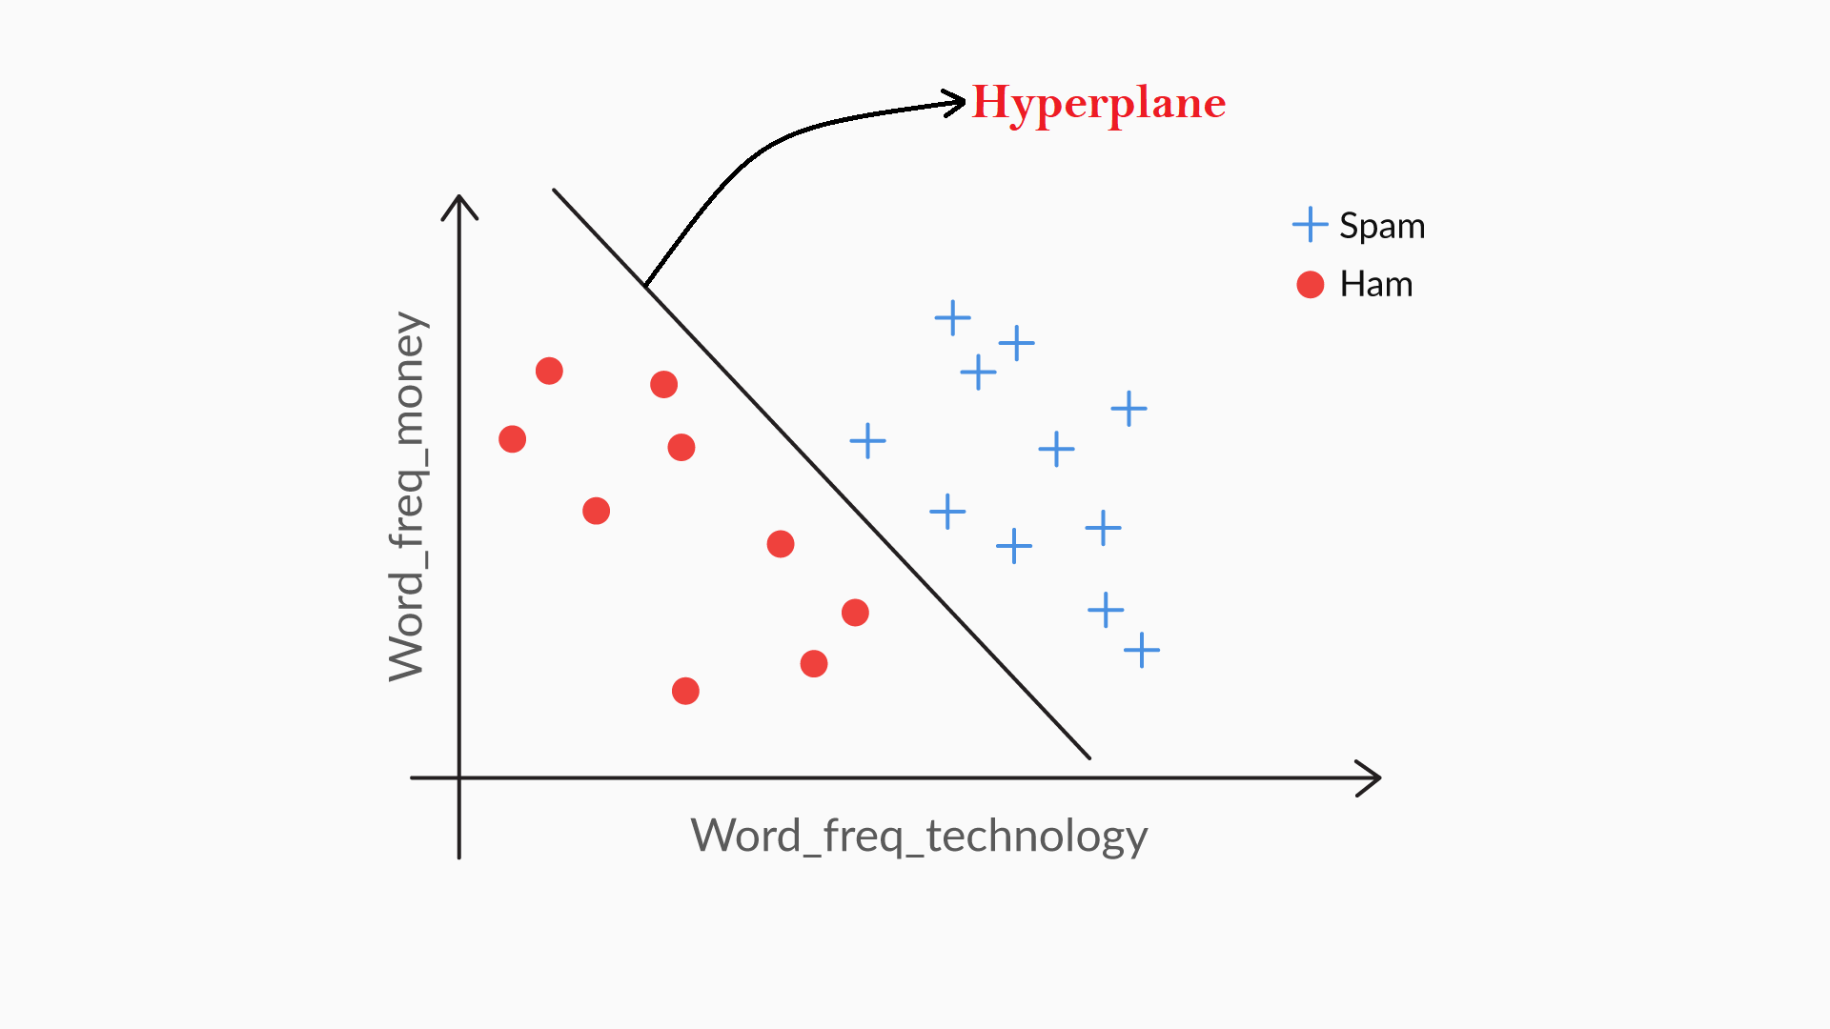
Concept of a Hyperplane in 2D:
A line that is used to classify one class from
another is also called a hyperplane.
SVMs need attributes in the numeric form.
See Dataset Spam.csv
You can find the data dictionary of the email spam dataset from the UCI repository.

Slide 5
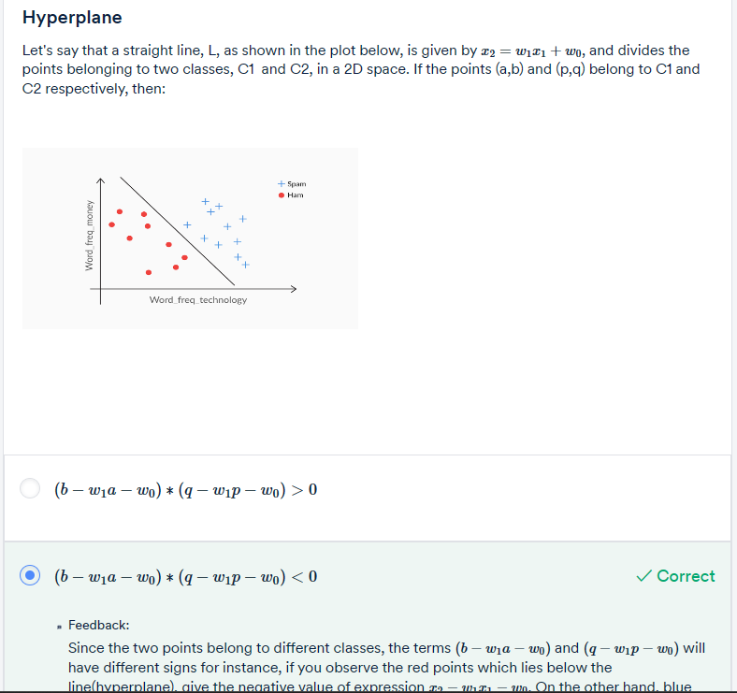
Question 1:

Slide 6
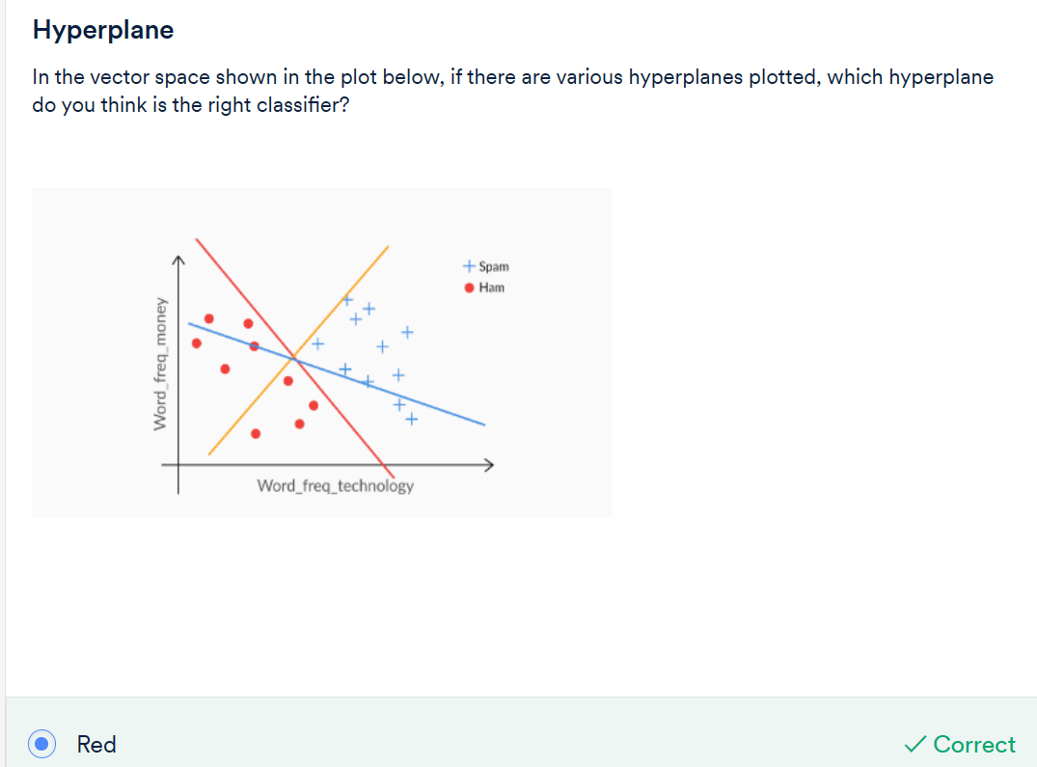
Question 2:

Slide 7
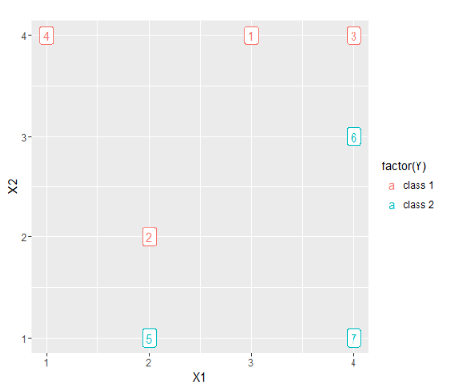
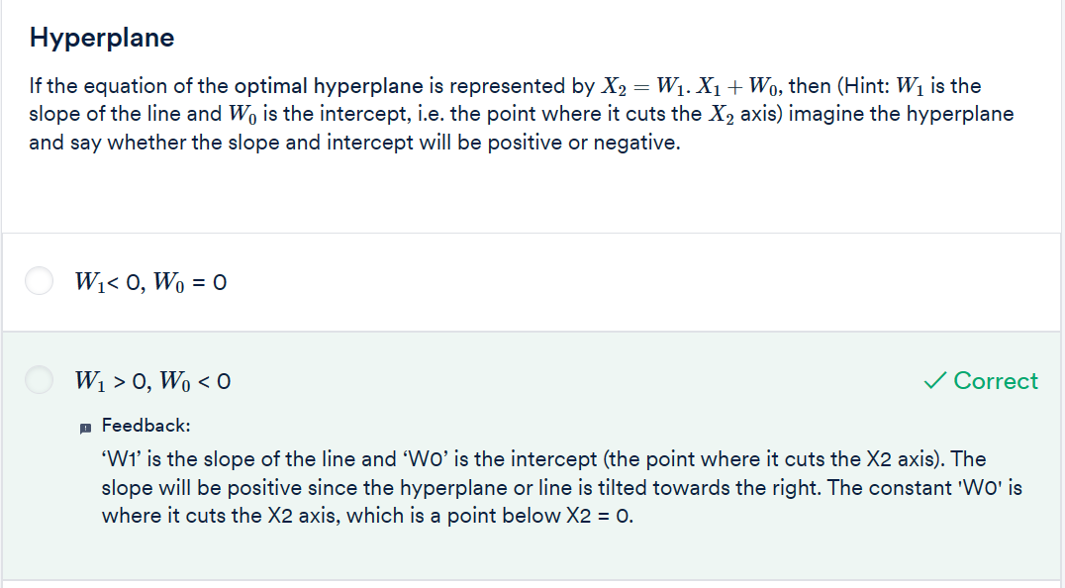
Question 2:

Slide 8
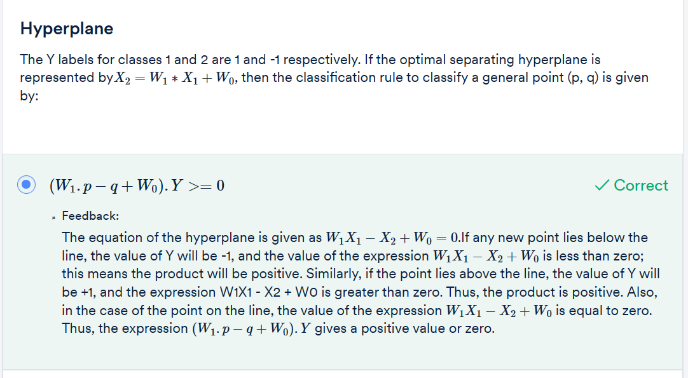
Question 3:

Slide 9
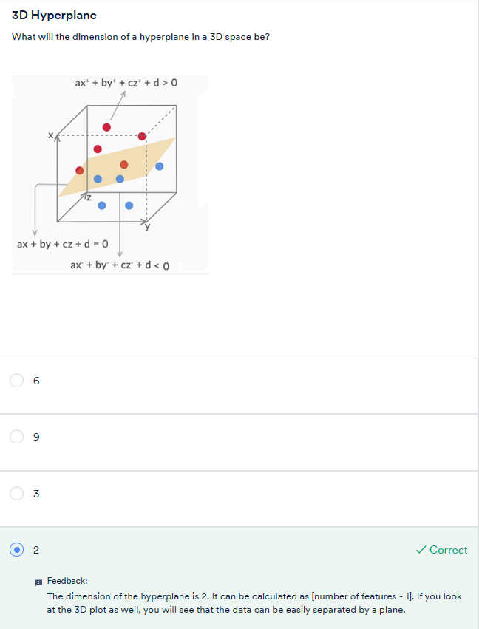
Concept of a
Hyperplane in 3D
Question: 4

Slide 10
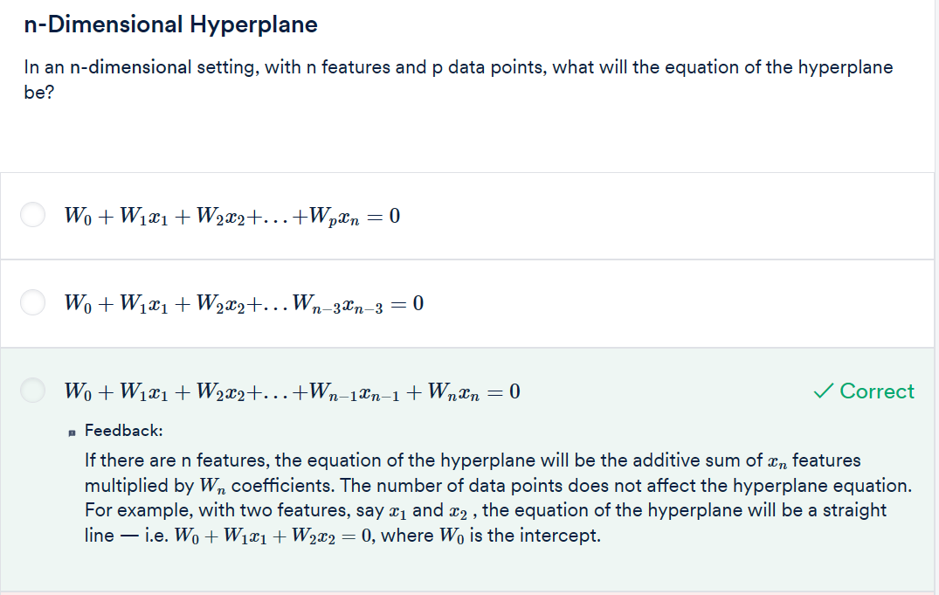
Question: 5

Slide 11
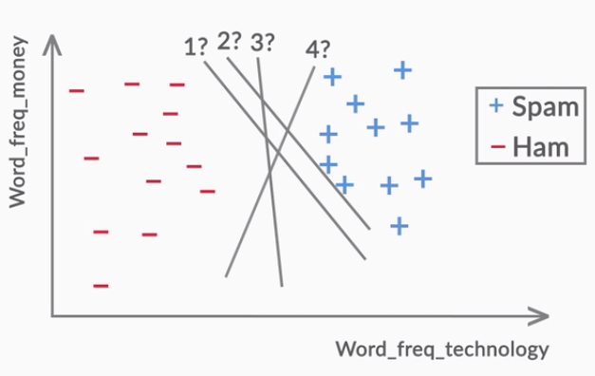
You can have multiple such lines correctly performing the classification task. But don't you think it would be a better idea to see which one is best suited?

Slide 12
The best line is the one that maintains the largest possible equal distance from the nearest points of both the classes. It is also referred to as a maximal margin classifier. You can think of the margin as a 'band' that the hyperplane has on both its sides.
There can be several lines (hyperplanes) possible in the same data set, as shown in the figure below, with different values of margins. Among these, the line with the maximum margin would be considered the best fit line for the given data.

Slide 13
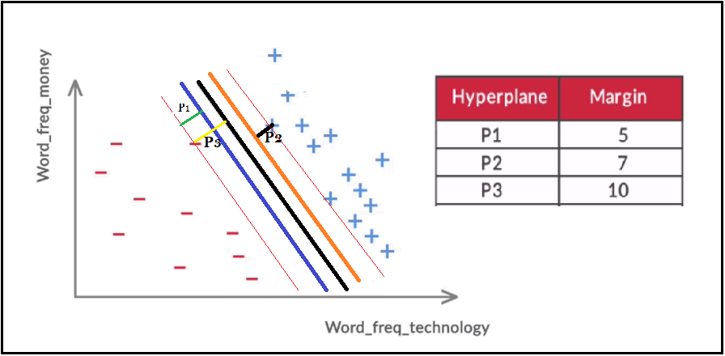
Suppose you’ve three different hyperplanes with three different margin values. Which hyperplane is the best for this data?

Slide 14
You will need to recall the concept of dot product of two vectors. Say there are two vectors A = [2, 3, 5] and B = [1, 0, 4], then the dot product of A and B is the element-wise multiplication of A and B, i.e. transpose(A). B = A'B = 2.1 + 3.0 + 5.4 = 22. Note that the dot product of two vectors returns a scalar number, in this case, 22.
Distance Formula for a Hyperplane: you will learn about the distance formula from a hyperplane. You can read more about the distance formula here.

Slide 15
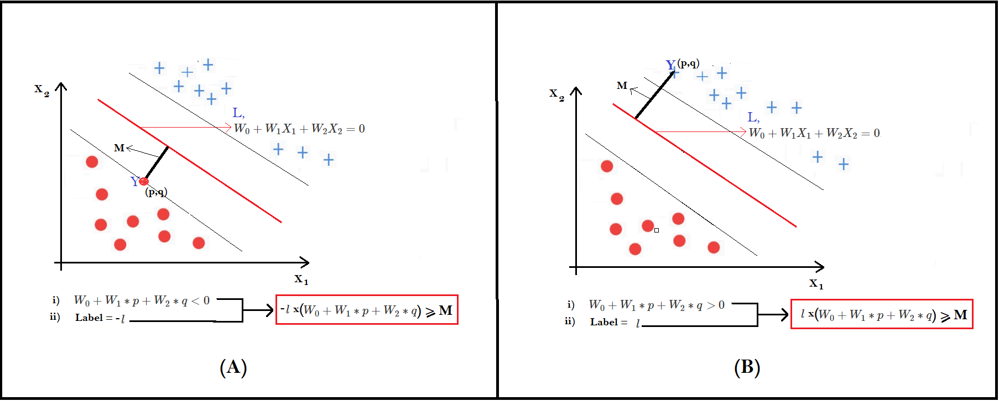
This is how the constraints help in formulating the maximal margin hyperplane.
Python code: SVM with Diabetes dataset

Slide 16
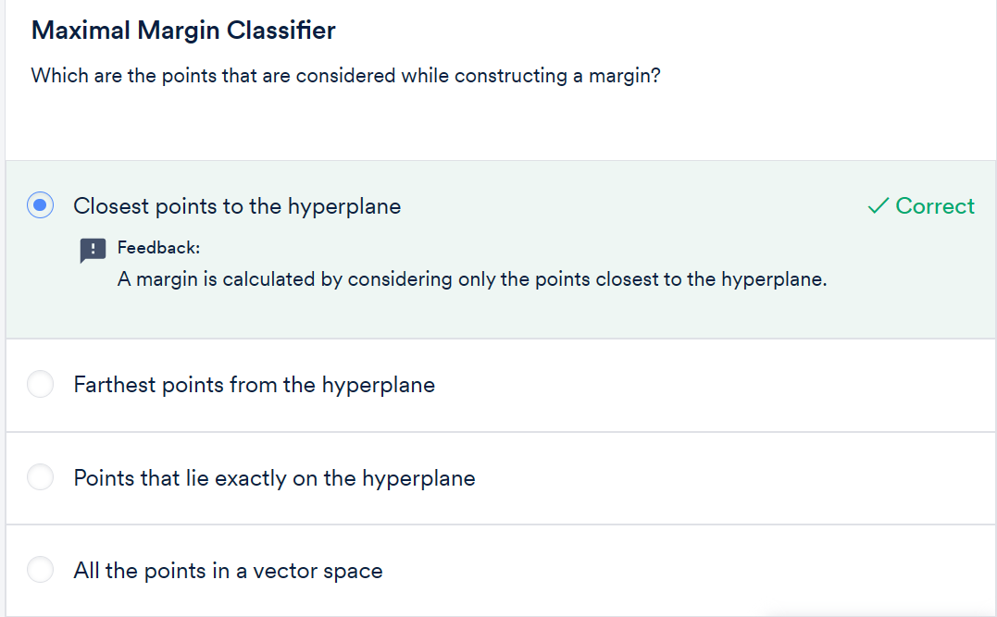
Question: 6

Slide 17
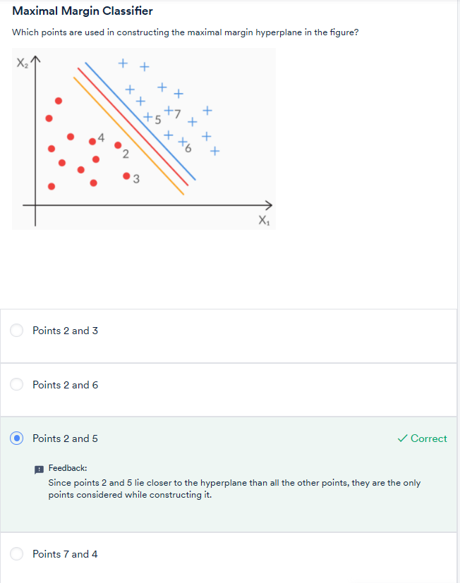
Question: 7

Slide 18
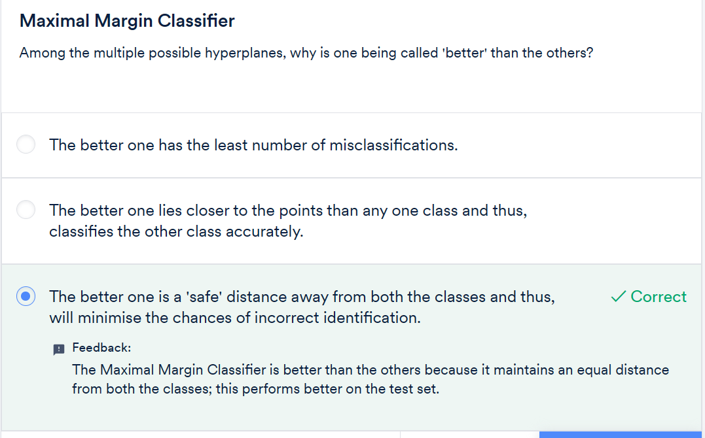
Question: 8

Slide 19
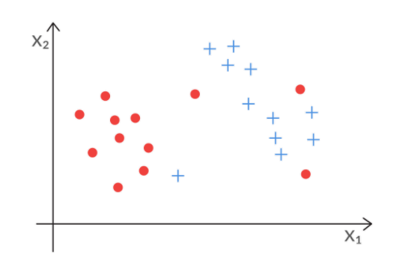
This means that the Maximal Margin Classifier will perform perfectly on the training data set. But on the unseen data, it may perform poorly. Also, there are cases where the classes cannot be perfectly separated. For example, if you look at figure 3 below, do you think the maximal margin can classify the data points perfectly?

Slide 20
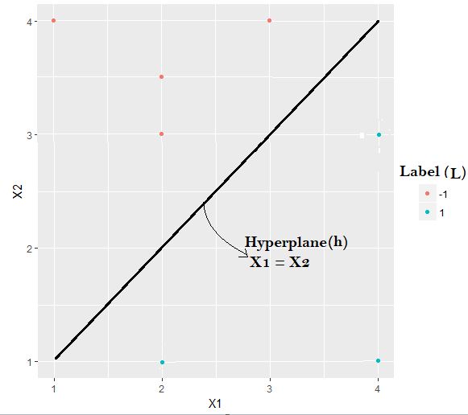
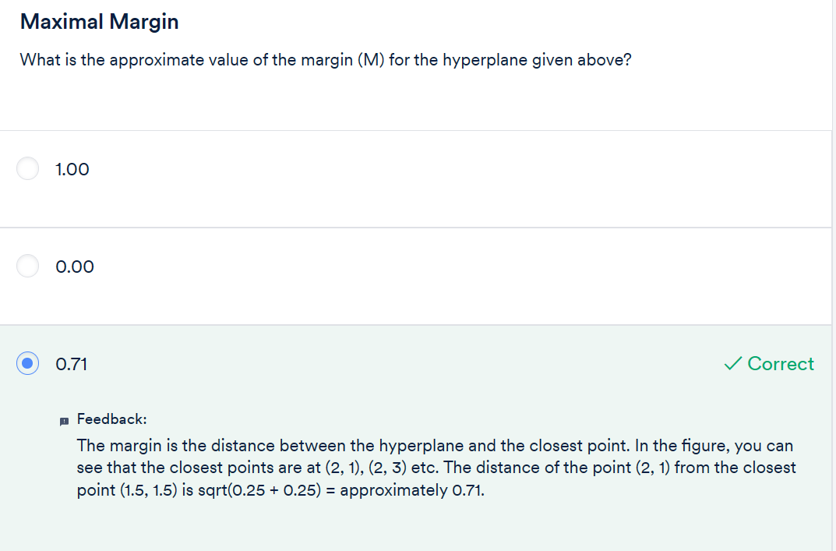
Question: 9

Slide 21
Introduction to Neural Network:
Structure of ANNs, inspired by the human brain
Perceptron: A simple idea as the basis for larger neural networks
Workings of artificial neurons
Structure and topology of neural networks
Hyperparameters and simplifying assumptions

Slide 22
Biological to Artificial Neuron:
As the name Artificial Neural Networks (ANNs) suggests, the design of ANNs is inspired by the human brain. Although not as powerful as the brain (yet), artificial neural networks are the most powerful learning models in the field of machine learning.
In the past few years, deep artificial neural networks have proven to perform surprisingly well on complex tasks such as speech recognition (converting speech into text), machine translation, and image and video classification. Such models are also commonly called deep learning models.

Slide 24

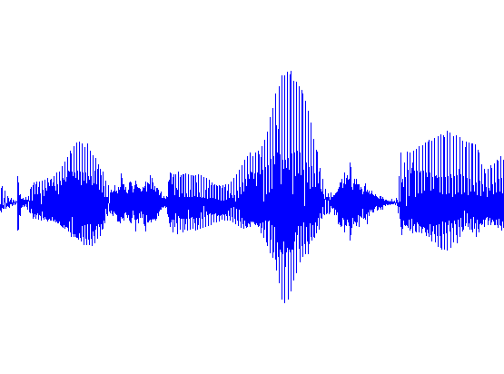

Typical goal of machine learning
input
output
Label: “Motorcycle”
Suggest tags
Image search
…
images/video
ML
Speech recognition
Music classification
Speaker identification
…
audio
ML
Web search
Anti-spam
Machine translation
…
text
ML

Slide 25




Face Recognition

Slide 26
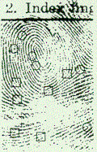
Fingerprint recognition

Slide 27
Optical Character Recognition

Slide 28
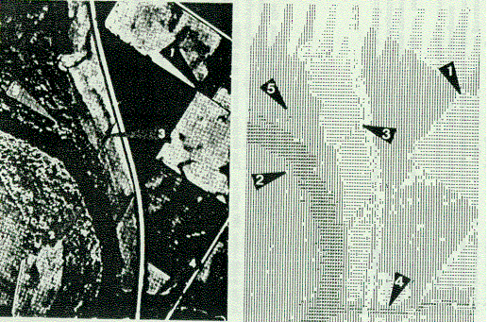
Detection of Oil Slicks
Given radar satellite images of coastal waters
Problem: Detect Oil Slicks

Slide 29
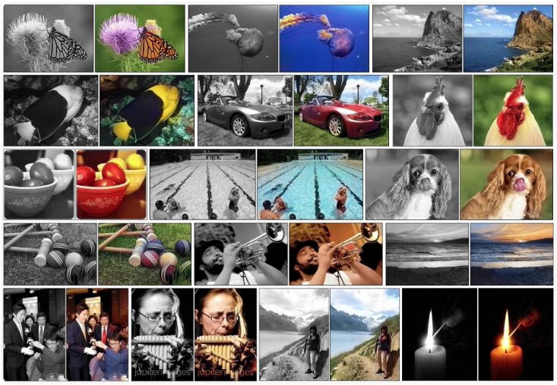
Automatic Colorization of Images

Slide 30
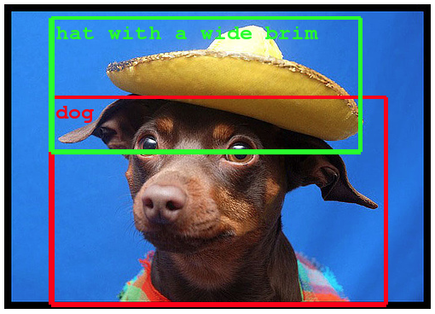
Object Classification/Detection in Photographs

Slide 31

Automatic Image Caption Generation

Slide 32

Health Care

Slide 33
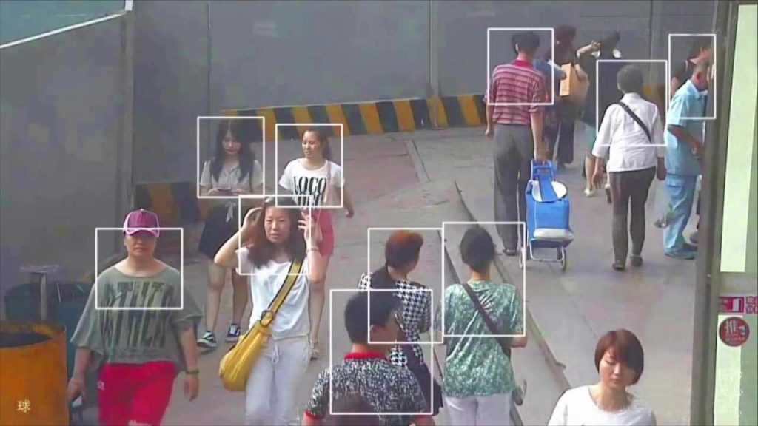
Real-Time Analysis of Behavior

Slide 34
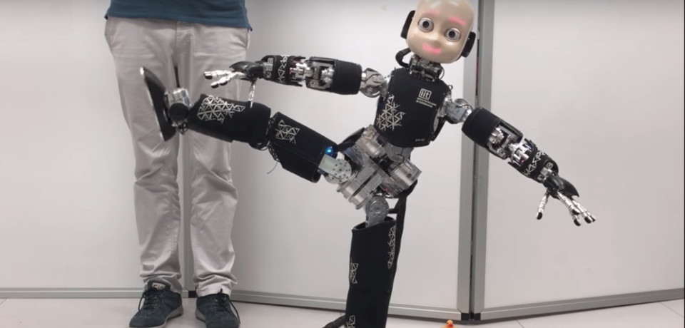
Robotics

Slide 35
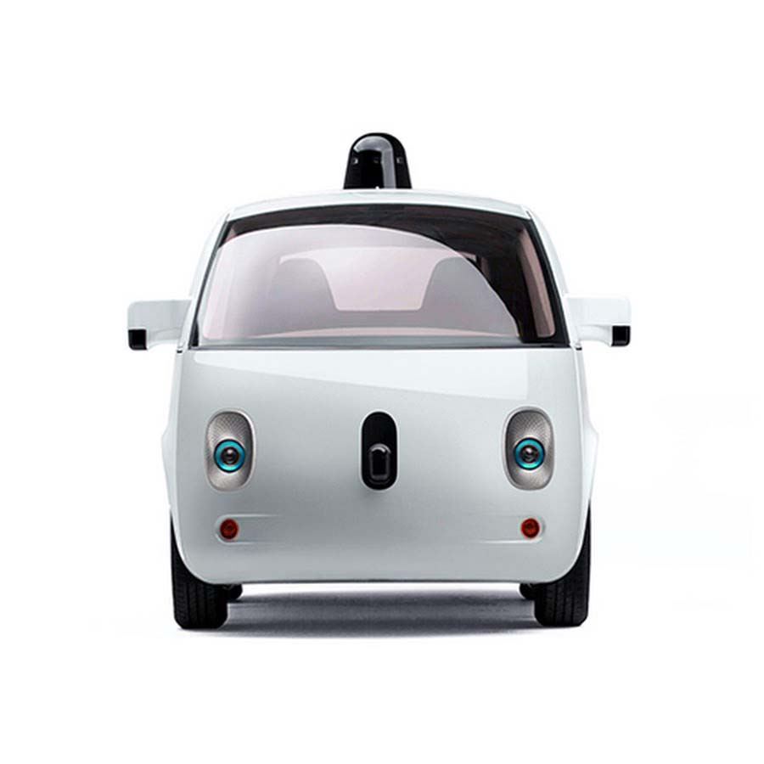
Self-Driving Cars

Slide 36
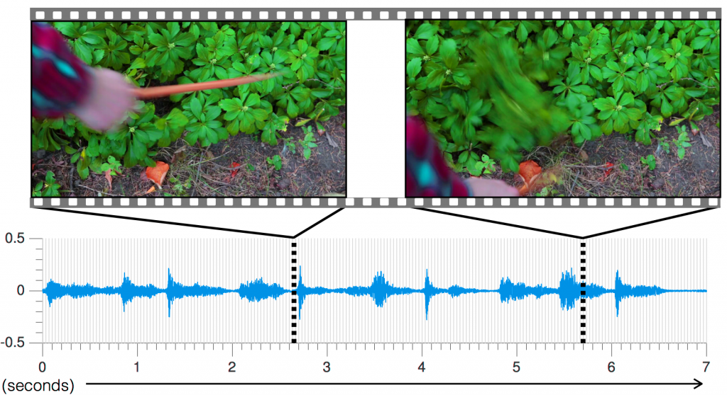
Including Sound in Videos

Slide 37

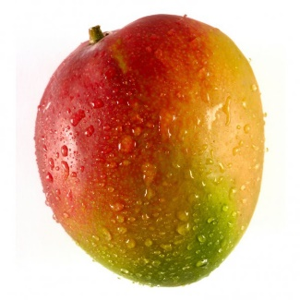
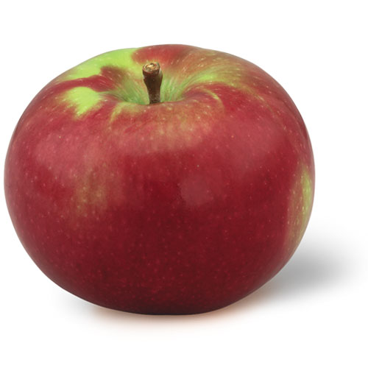

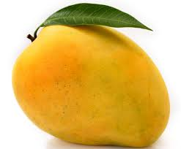
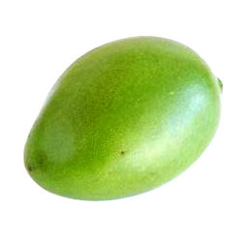
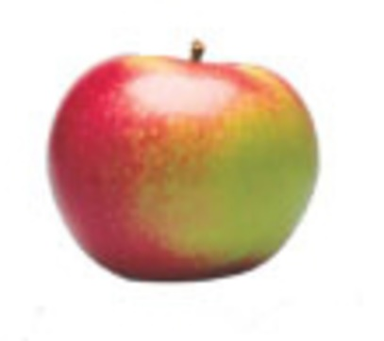

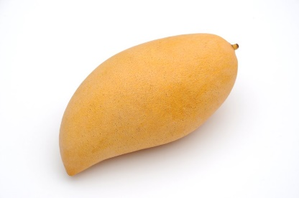
Apple
Banana
Mango

Slide 38
Fruit
Name of Fruit
Apple
Banana
Mango
f(Fruit) Name of Fruit

Slide 39
Classification
f(Feature_vec) Fruit_type
Feature Vector |  | Fruit_type
Color | Shape
Red | Elliptical | Apple
Yellow | Elongated | Banana
Yellow | Elliptical | Mango
Green | Elliptical | Mango
Green | Elongated | Banana

Slide 40
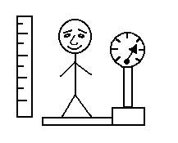
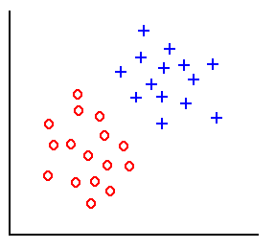
Classification
height
weight
Training examples

Slide 41
Classification
height
weight
Training examples
D_{i} = distance(x, x_{i}), i=1,2,…,l

Slide 42
Classification
height
weight
Training examples
Linear classifier:
w.x + w₀ = 0

Slide 43
Classification
height
weight
Training examples
Linear classifier:
w.x + w₀ = 0

Slide 44
Decision Surface of a Perceptron
x₂
x₂
x₁
x₁
Linearly separable (AND Problem)
Linearly separable (NAND Problem)
For AND
X₁ X₂ y
0 0 0
0 1 0
1 0 0
1 1 1
For NAND
X₁ X₂ y
0 0 1
0 1 1
1 0 1
1 1 0

Slide 45
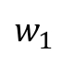
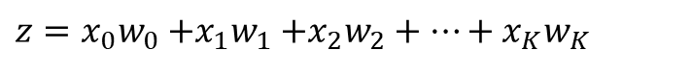
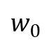
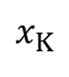
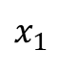
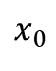
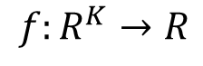
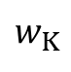
Elements of Neural Network
Neuron
$$f:R^{K}→R$$
$$x_{0}$$
$$z={x_{0}w}_{0}{+x_{1}w}_{1}+x_{2}w_{2}+⋯+x_{K}w_{K}$$
$$w_{0}$$
$$x_{1}$$
$$w_{1}$$
h(z)
…
$$w_{K}$$
$$x_{K}$$
Activation function
weights
Notes:
sigmoid

Slide 46
Elements of Neural Network
Neuron
$$f:R^{K}→R$$
$$x_{0}$$
$$z={x_{0}w}_{0}{+x_{1}w}_{1}+x_{2}w_{2}+⋯+x_{K}w_{K}$$
$$w_{0}$$
$$x_{1}$$
$$w_{1}$$
h(z)
…
$$w_{K}$$
$$x_{K}$$
weights
Activation function
1 if Σ w_{i} x_{i} > 0
h(z)=
0 otherwise
Notes:
sigmoid

Slide 47
Training Perceptrons
For AND
X₁ X₂ y
0 0 0
0 1 0
1 0 0
1 1 1
X₀
W₀ = ?
X₁
th= 0.0
W₁ = ?
W₂ = ?
X₂
Initialize with random weight values

Slide 48
Training Perceptrons
For AND
X₁ X₂ y
0 0 0
0 1 0
1 0 0
1 1 1
X₀
W₀ = -0.3
X₁
th= 0.0
W₁ = 0.5
W₂ = -0.4
X₂

Slide 49
Gradient Descent Learning Rule
Train the w_{i}’s such that they minimize the squared error
E[w₁,…,w_{n}] = ½ Σ_{d∈D} (y_{d}-h_{d})²
where D is the set of training examples

Slide 50
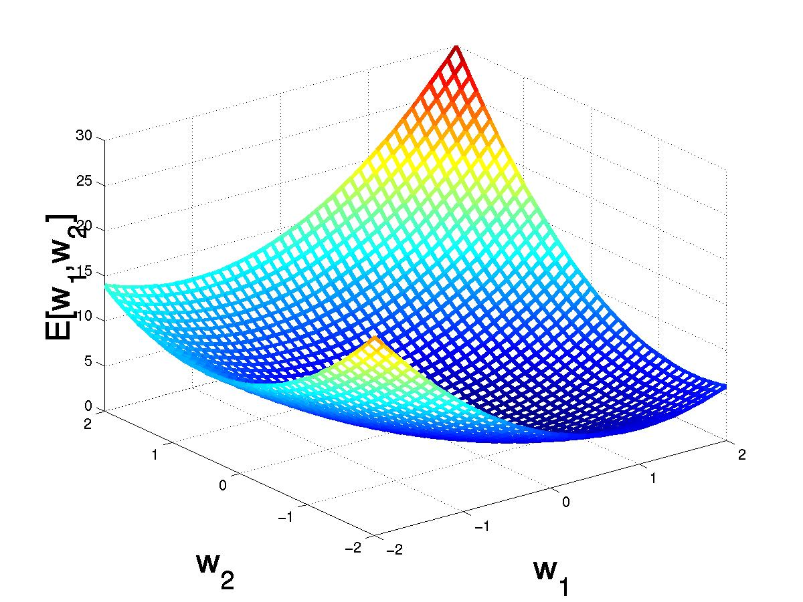
Gradient Descent
(w₁,w₂)
Gradient:
∇E[w]=[∂E/∂w₀,… ∂E/∂w_{n}]
Δw=- η∇E[w]
(w₁+Δw₁,w₂ +Δw₂)
Δw_{i}=- η∂E/∂w_{i}
=- η∂/∂w_{i} 1/2Σ_{d}(y_{d}-h_{d})²
= -η ∂/∂w_{i} 1/2Σ_{d}(y_{d}-Σ_{i} w_{i} x_{i})²
= η Σ_{d}(y_{d}- h_{d})(x_{i})
Consider 0<η <=1

Slide 51
Weight Updation
For AND
X₁ X₂ y
0 0 0
0 1 0
1 0 0
1 1 1
W₀= -0.3 + [(0-0)1+(0-0)1+(0-1)1+(1-0)1]= -0.3
W₁= 0.5 + [(0-0)0+(0-0)0+(0-1)1+(1-0)1]= 0.5
W₂= -0.4 + [(0-0)0+(0-0)1+(0-1)0+(1-0)1]= 0.6

Slide 52
Weight Updation
For AND
X₁ X₂ y
0 0 0
0 1 0
1 0 0
1 1 1
W₀= -0.3 + [(0-0)1+(0-1)1+(0-1)1+(1-1)1]= -2.3
W₁= 0.5 + [(0-0)0+(0-1)0+(0-1)1+(1-1)1]= -0.5
W₂= 0.6 + [(0-0)0+(0-1)1+(0-1)0+(1-1)1]= -0.4

Slide 53
Weight Updation
For AND
X₁ X₂ y
0 0 0
0 1 0
1 0 0
1 1 1
W₀= -2.3 + [(0-0)1+(0-0)1+(0-0)1+(1-0)1]= -1.3
W₁= -0.5 + [(0-0)0+(0-0)0+(0-0)1+(1-0)1]= 0.5
W₂= -0.4 + [(0-0)0+(0-0)1+(0-0)0+(1-0)1]= 0.6

Slide 54
Weight Updation
For AND
X₁ X₂ y
0 0 0
0 1 0
1 0 0
1 1 1
W₀= -1.3 + [(0-0)1+(0-0)1+(0-0)1+(1-0)1]= -0.3
W₁= 0.5 + [(0-0)0+(0-0)0+(0-0)1+(1-0)1]= 1.5
W₂= 0.6 + [(0-0)0+(0-0)1+(0-0)0+(1-0)1]= 1.6

Slide 55
Weight Updation
For AND
X₁ X₂ y
0 0 0
0 1 0
1 0 0
1 1 1
W₀= -0.3 + [(0-0)1+(0-0)1+(0-1)1+(1-1)1]= -1.3
W₁= 1.5 + [(0-0)0+(0-0)0+(0-1)1+(1-1)1]= 0.5
W₂= 1.6 + [(0-0)0+(0-0)1+(0-1)0+(1-1)1]= 1.6

Slide 56
Weight Updation
For AND
X₁ X₂ y
0 0 0
0 1 0
1 0 0
1 1 1
W₀= -1.3 + [(0-0)1+(0-1)1+(0-0)1+(1-1)1]= -2.3
W₁= 0.5 + [(0-0)0+(0-1)0+(0-0)1+(1-1)1]= 0.5
W₂= 1.6 + [(0-0)0+(0-1)1+(0-0)0+(1-1)1]= 0.6

Slide 57
Weight Updation
For AND
X₁ X₂ y
0 0 0
0 1 0
1 0 0
1 1 1
W₀= -2.3 + [(0-0)1+(0-0)1+(0-0)1+(1-0)1]= -1.3
W₁= 0.5 + [(0-0)0+(0-0)0+(0-0)1+(1-0)1]= 1.5
W₂= 0.6 + [(0-0)0+(0-0)1+(0-0)0+(1-0)1]= 1.6

Slide 58
Weight Updation
For AND
X₁ X₂ y
0 0 0
0 1 0
1 0 0
1 1 1
W₀= -1.3 + [(0-0)1+(0-1)1+(0-1)1+(1-1)1]= -3.3
W₁= 1.5 + [(0-0)0+(0-1)0+(0-1)1+(1-1)1]= 0.5
W₂= 1.6 + [(0-0)0+(0-1)1+(0-1)0+(1-1)1]= 0.6

Slide 59
Weight Updation
For AND
X₁ X₂ y
0 0 0
0 1 0
1 0 0
1 1 1
W₀= -3.3 + [(0-0)1+(0-0)1+(0-0)1+(1-0)1]= -2.3
W₁= 0.5 + [(0-0)0+(0-0)0+(0-0)1+(1-0)1]= 1.5
W₂= 0.6 + [(0-0)0+(0-0)1+(0-0)0+(1-0)1]= 1.6

Slide 60
Decision Surface of a Perceptron
x₂
x₂
x₁
x₁
Linearly separable (AND Problem)
Linearly separable (NAND Problem)
For AND
X₁ X₂ y
0 0 0
0 1 0
1 0 0
1 1 1
For NAND
X₁ X₂ y
0 0 1
0 1 1
1 0 1
1 1 0

Slide 61
Decision Surface of a Perceptron
x₂
x₂
x₁
x₁
Linearly separable (OR Problem)
NonLinearly separable (XOR Problem)
For OR
X₁ X₂ y
0 0 0
0 1 1
1 0 1
1 1 1
For XOR
X₁ X₂ y
0 0 0
0 1 1
1 0 1
1 1 0

Slide 62
Decision Surface of a Perceptron
x₂
XOR can solved as:
XOR(x₁, x₂)= AND( OR(x₁, x₂), NAND(x₁, x₂))
x₁
NonLinearly separable (XOR Problem)
For XOR
X₁ X₂ y
0 0 0
0 1 1
1 0 1
1 1 0

Slide 63
XOR Problem
OR
x0
AND
x1
NAND
x2
XOR(x₁, x₂)= AND( OR(x₁, x₂), NAND(x₁, x₂))

Slide 64
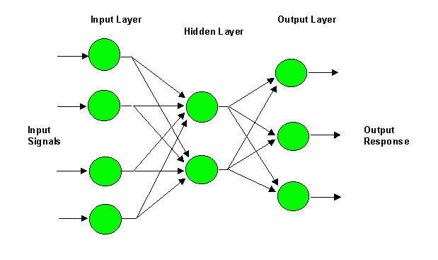
Multilayer Perceptron (MLP)
i
W_{ji}
j
W_{kj}
k

Slide 65
Multilayer Perceptron (MLP)
i
W_{ji}
j
W_{kj}
k
y_{j} = f(net_{j})
z_{k} = f(net_{k})

Slide 66
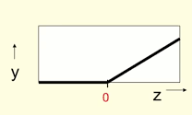

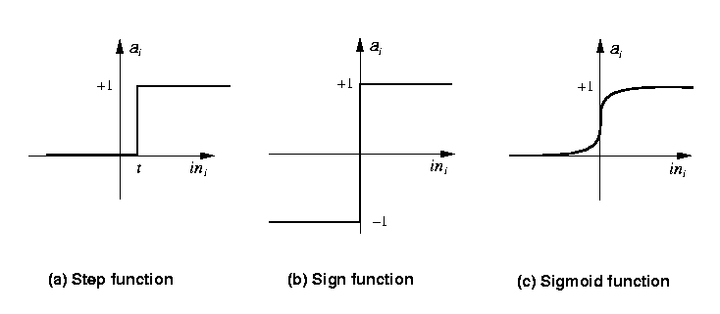

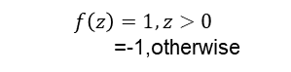
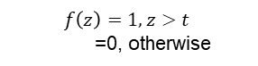
Activation functions
$$f\left(z\right)=1, z>t$$
=0, otherwise
$$f\left(z\right)=1, z>0$$
=-1,otherwise
$$f\left(z\right)=1/(1+\exp\left(−z\right))$$
Rectified Linear Unit
$$f\left(z\right)=max⁡(0,z)$$

Slide 67
Confusion Matrix
Actual class\Predicted class | P | _{N}
P | True Positives (TP) | False Negatives (FN)
N | False Positives (FP) | True Negatives (TN)

Slide 68
Evaluation Metrics
Classifier Accuracy, or recognition rate: percentage of test set tuples that are correctly classified
Accuracy = (TP + TN)/All
Error rate: 1 – accuracy, or
Error rate = (FP + FN)/All
Sensitivity: True Positive recognition rate
Sensitivity = TP/P
Specificity: True Negative recognition rate
Specificity = TN/N
68

Slide 69
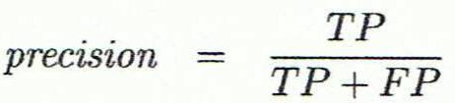
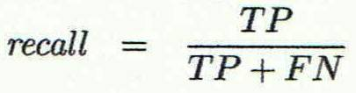

Evaluation Metrics
Precision: exactness – what % of tuples that the classifier labeled as positive are actually positive
Recall: completeness – what % of positive tuples did the classifier label as positive?
Inverse relationship between precision & recall
F measure (F₁ or F-score): harmonic mean of precision and recall,
69

Slide 70
Receiver Operating Characteristics (ROC )Curves
The area under the ROC curve is a measure of the accuracy of the model
A model with perfect accuracy will have an area of 1.0
70

Slide 71

Biological to Artificial Neuron:
the biological neuron works as follows: it receives signals through its dendrites, which are either amplified or inhibited, as they pass through the axons to the dendrites of other neurons.

Slide 72
Biological to Artificial Neuron:
Artificial neural networks are a collection of many simple devices called artificial neurons. The network ‘learns’ to conduct certain tasks, such as recognising a cat, by training the neurons to ‘fire’ in a certain way when given a particular input, such as a cat. In other words, the network learns to inhibit or amplify the input signals to perform a certain task, such as recognising a cat, speaking a word or identifying a tree.

Slide 73
Perceptron:
Consider a sushi place you plan to visit this Saturday. There are various factors that would affect this decision, such as:
The distance between the sushi place and your home
The cost of the food they serve there
The number of people accompanying you
You make such a decision based on multiple such factors. Also, each decision factor has a different ‘weight’, for example, the distance of the place might be more important than the number of people accompanying you.

Slide 74
Perceptron:
Perceptrons work in a similar manner. They take some signals as inputs and perform a set of simple calculations to arrive at a decision.
A perceptron acts as a tool that enables you to make a decision based on multiple factors. Each decision factor holds a different ‘weight’, for example, your neighbor, Rohit, may consider the amenities around the house to be more important than the other two factors.

Slide 75


Slide 76


Slide 77


Slide 78


Slide 79

Artificial Neuron
Now that you have a basic understanding of perceptrons, let’s study the design of Artificial Neural Networks (ANNs).
Neural networks are a collection of artificial neurons arranged in a particular structure. In this segment, you will understand how a single artificial neuron works, i.e., how it converts inputs into outputs. You will also understand the topology or structure of large neural networks. Let’s get started by understanding the basic structure of an artificial neuron.

Slide 80

Artificial Neuron
multiple artificial neurons in a neural network are arranged in different layers. The first layer is known as the input layer, and the last layer is called the output layer. The layers in between these two are the hidden layers.
The number of neurons in the input layer is equal to the number of attributes in the data set, and the number of neurons in the output layer is determined by the number of classes of the target variable (for a classification problem).
For a regression problem, the number of neurons in the output layer would be 1 (a numeric variable). Take a look at the image given below to understand the topology of neural networks in the case of classification and regression problems.

Slide 81


Inputs and Outputs of a Neural Network:

Slide 82

Question: 10

Slide 83

Question 11:

Slide 84

Question 12:

Slide 85

Depending on the nature of the given task, the outputs of neural networks can either be in the form of classes (if it is a classification problem) or numeric (if it is a regression problem). One of the commonly used output functions is the softmax function for classification. Take a look at the graphical representation of the softmax function shown below.

Slide 86


Slide 87

Workings of a Single Neuron
In this segment, you will learn how to define the input, the processing of this input and the corresponding output from a single neuron. In the video below, we will be showing you in detail the structure and working of an artificial neuron.

Slide 88

An in-depth representation of the cumulative input as the output is given below:

Slide 89

Different Activation Functions:

Slide 90


Slide 91


Slide 92


Slide 93
Parameters and Hyperparameters of Neural Network
Neural networks require rigorous training, but what does it mean to train neural networks? What are the parameters that the network learns during training, and what are the hyperparameters that you (as the network is designed) need to specify beforehand?
Neural networks are no different; they are trained on weights and biases.

Slide 94
During training, the neural network learning algorithm fits various models to the training data and selects the best prediction model. The learning algorithm is trained with a fixed set of hyperparameters associated with the network structure. Some of the important hyperparameters to consider to decide the network structure are given below:
Number of layers
Number of neurons in the input, hidden and output layers
Learning rate (the step size taken each time we update the weights and biases of an ANN)
Number of epochs (the number of times the entire training data set passes through the neural network)
The purpose of training the learning algorithm is to obtain optimum weights and biases that form the parameters of the network.

Slide 95

The notations that you will come across going forward are as follows:
W represents the weight matrix.
b stands for bias.
x represents the input.
y represents the ground truth label.
p represents the probability vector of the predicted output for the classification problem. hL represents the predicted output for the regression problem (where L represents the number of layers).

Slide 96

The superscript represents the layer number. The weight matrix connecting the first hidden layer to the second hidden layer is denoted by W2.

Slide 97

Assumptions for Simplifying Neural Network
Since large neural networks can potentially have extremely complex structures, certain assumptions are made to simplify the way in which information flows in them.

Slide 98


Slide 99
SVM Case-study:
Linear+SVM+-+Email+Spam+Classifier
The dataset can be downloaded here: https://archive.ics.uci.edu/ml/datasets/spambase

Slide 100
Linear Line Example:
slr_excel_demonstration_1

Slide 101

Introduction to Feedforward Neural Network:

Slide 102

Flow of Information Between Layers:

Slide 103


Slide 104

Forward Pass – Demonstration:

Slide 105


Feedforward Algorithm:

Slide 106

Loss Function:

Slide 107

Loss Function:

Slide 108

Gradient Descent:

Slide 109
Introduction to Backpropagation:
the following topics will be covered:
Gradient descent in neural networks
Backpropagation algorithm
Introduction to TensorFlow
Implementation of a neural network using TensorFlow

Slide 110


Gradient Descent for Backpropagation:

Slide 111


Numerical Example Demonstrating Backpropagation:

Slide 112
Introduction to Tensorflow:
TensorFlow is an open-source platform for developing end-to-end machine learning (ML) solutions. The TensorFlow platform contains services such as TensorFlow.js, TensorFlow lite, and TensorFlow Extended, which are used to develop applications for browsers, mobile platforms, and large production environments, respectively.
TensorFlow is a deep learning library developed by Google. It is used widely in the industry for several different applications. Some of these applications include smart text in Gmail, Google Translate and Google Lens. Now, in the next video, Avishek will discuss TensorFlow and its features.

Slide 113

Tensors:
A tensor is the fundamental data structure used in TensorFlow. It is a multidimensional array with a uniform data type. The data type for an entire tensor is the same.

Slide 114

Tensors:
A tensor is the fundamental data structure used in TensorFlow. It is a multidimensional array with a uniform data type. The data type for an entire tensor is the same.

Slide 115
Fundamental concepts of coding in TensorFlow, although we strongly recommend you to visit the Tensorflow documentation for better coverage.
You can visit this page to read about all the available mathematical functions.

Slide 116
Python Example:
NN_from_scratch_house_price_data
house_price_full+(2)

Slide 117
Introduction to the Module
Welcome to the module on 'Time Series Forecasting – I
Aware of sales forecasting, weather forecasting, and demand forecasting. You might have seen anchors and stock market experts accurately predicting how the next day, month, or year would turn out in terms of the weather or the prices like they are Nostradamus.
Python Code: Time+series+code+part1

Slide 118
THANK YOU

